Slide 1






The Moon! Oh, the Moon! Pt 4

Slide 2


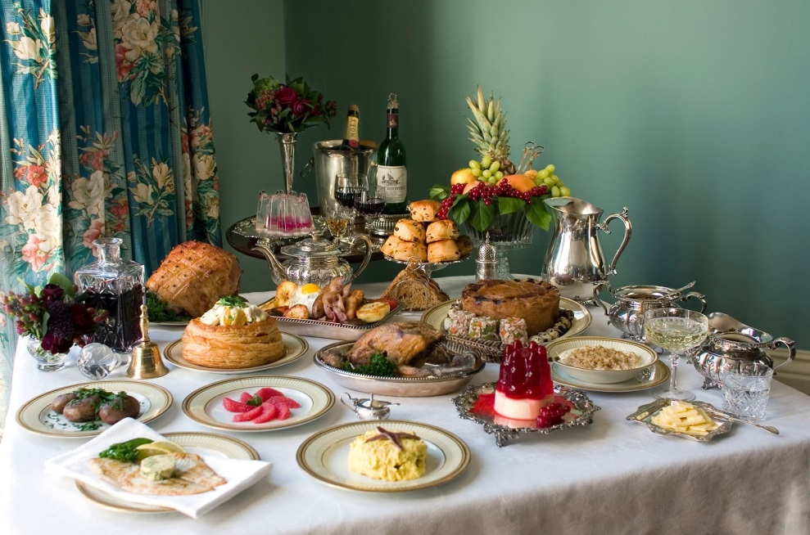
What’s On The Table For This Study?
Pauper’s Table
King’s Table
Part 2 of H3391 <yerach> is the “real-meal” deal.
Will there be any surprises on the menu?

Slide 3
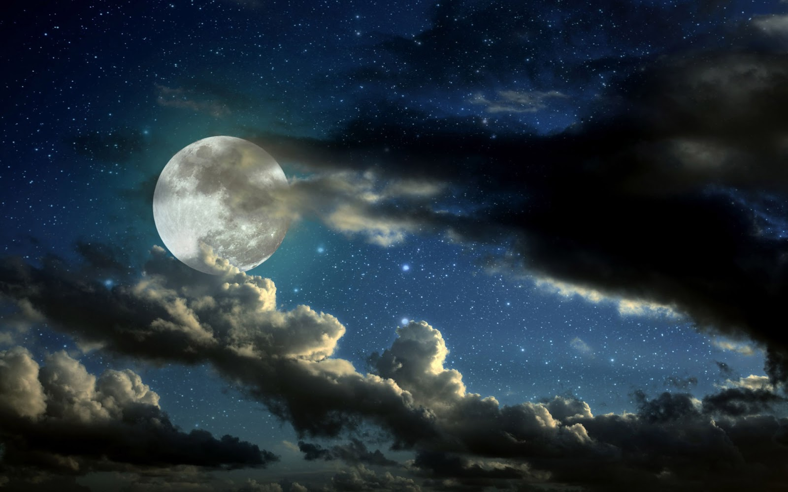
Covenant Calendar Gets to Work!
The Covenant of the Calendar was given on the 1st day of creation starting out with the Covenant of the Day and Covenant of the Night (Jer 33:20-25).
Foundation: It’s all about understanding the word evening <ereb> H6153.
Covenant Calendar is a very important covenant given first before the covenants of the:
1) “midst of the week”
2) marriage on Day 6;
3) Sabbath on Day 7.

Slide 4
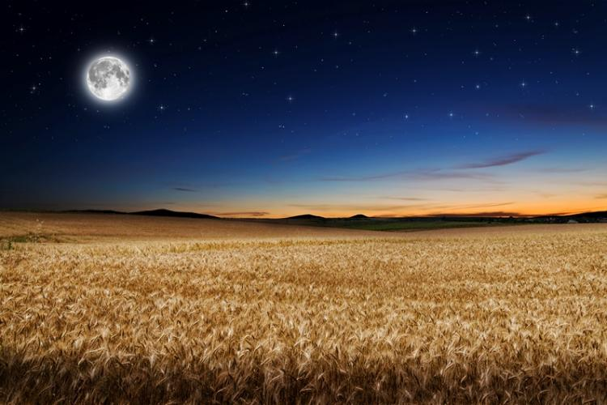

The Covenant of Calendar was designed to bring
(and keep) any/all individuals in a full covenant relationship with their Creator forever.
Covenant Calendar is fully capable of exposing the darkness of ALL counterfeit calendars removing all doubt so Yahuah’s people can know when to meet with Him on His “appointed times.”

Slide 5


This study is part of the Grand Finale Exposure
for H3391 <yerach> (lunar cycle).
Remember: the base of
this calendar study
is all about
“EVENING”
… and …
(Pun intended!)

Slide 6

Let’s Get
Started!

Slide 7
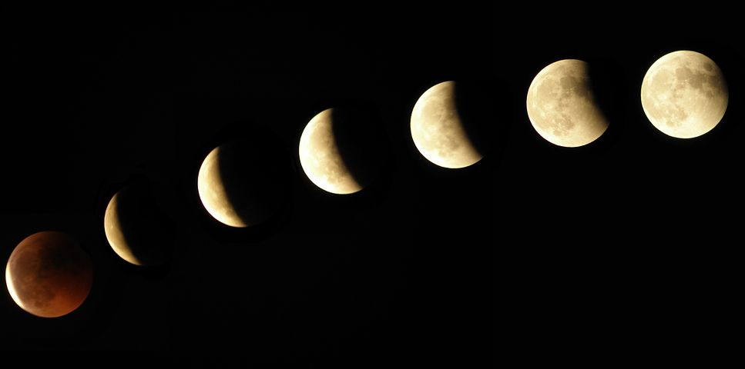
The Moon! Oh, the Moon!
Part 4
“The Moonth! Oh, the Moonth?”
Our Questions: Oh Moon!
1) Are you the master of counterfeit calendars?
2) Does creation serve you?
3) Or … do you serve creation?

Slide 8
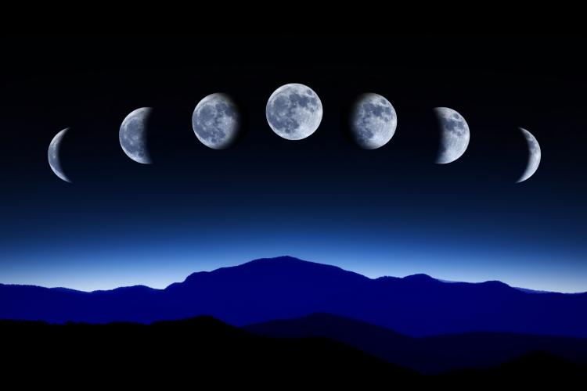
The 2nd part of H3391 <yerach> (verb)
[primitive root of H3394 <yareach> (noun)] will be studied in this lesson.
H3391 <yerach> will be examined as the
verb/action component of the moon.
Question:
Will H3391 <yerach> be able to qualify for the commencement of Yahuah’s set-apart month?

Slide 9
Moon Hebrew Word #s & Grammar
Hebrew #
Part of speech
R
E
V
I
E
W
1. H3394 = 26 listings <yareach>
2. H3391 = 2 listings <yerach>
3. H3842 = 3 listings <lebanah>
4. H7720 = 1 listing <saharon>
5. H2320 = 20 listings <chodesh>
Total of 52 references.
Noun – literal moon
verb – lunation cycle
Adjective – color
Simile – comparison
Verb – repetition
Question: are there really
2 verb forms for ONE “moon”?

Slide 10



[#3] H3842 MOON <lebanah>
Taking a Closer Look
R
E
V
I
E
W
The color or whiteness
of the moon.
The moon as white!
References Found:
Strong’s: 3
Englishman’s: 3
Adjective
Notes:
108n June 21st

Slide 11
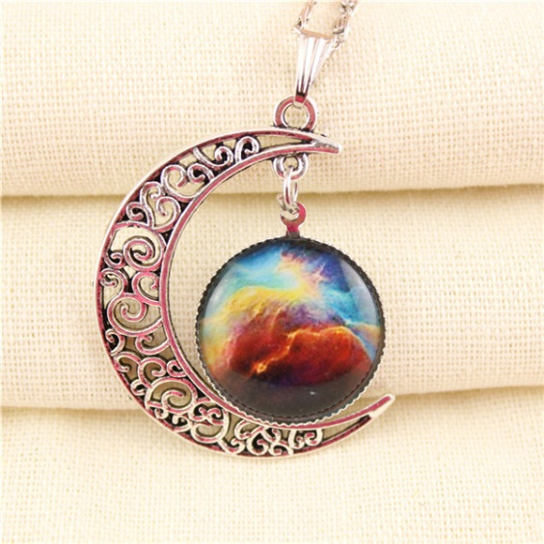
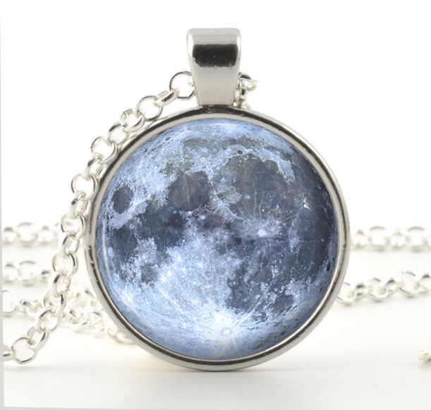
[#4] H7720 MOON <saharon>
Taking a Closer Look
R
E
V
I
E
W
A simile/comparison
[using the words “like” or “as”]
of something that is round
like the moon.
References Found:
Strong’s: 1
Englishman’s: 3
Simile
Notes:
Aug 16 730 pm

Slide 12

Mapping the Topics for H3391 Part 1
1. Creation Patterns
5.
R
E
V
I
E
W
Perfection, Devastation, Restoration
6.
2. Creation Months
1st Day – 30 day month
4th Day – 30 day month
7.
3. Lunar Months
8.
Sidereal – 27.3 day month
Synodic – 29.5 day month
4.
9.

Slide 13
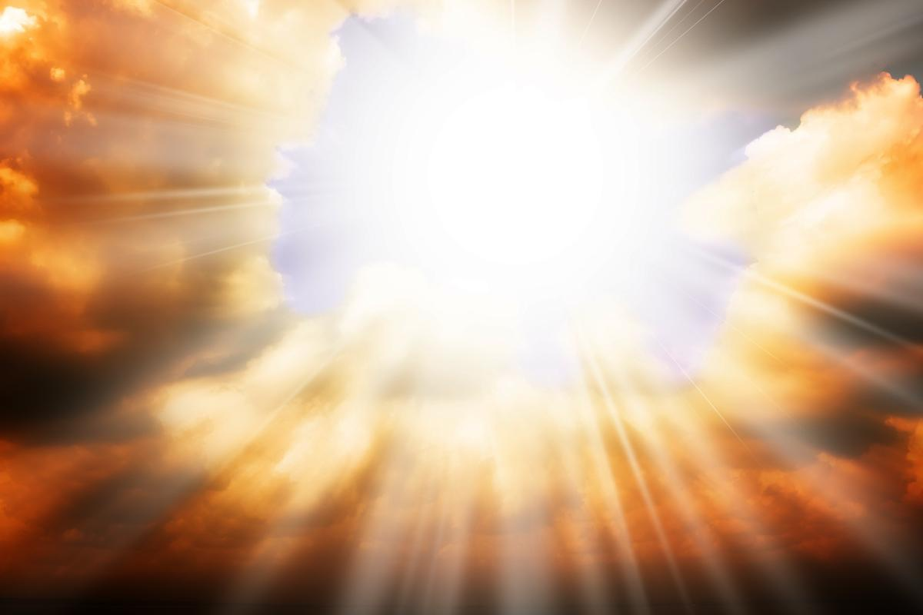
Perfection devastation restoration
R
E
V
I
E
W
#1 Creation Patterns
1 SLIDE

Slide 14

A Scriptural Pattern & the Moon
This Pattern has many repetitions:
Perfection ~ Devastation ~ Restoration
Examples for this pattern:
  First day of Creation
  Adam & Eve
  Yahuah’s people & their disobedience
  Creation Moon; Hezekiah’s miracle altered the moon cycle 3300 years after creation; moon will be restored in the new Earth.
R
E
V
I
E
W
14
Gen 1 Pattern: vs 1: Perfection; vs 2: Devastation; vs 3: Restoration.
Includes: creation week; adam and eve; yah’s people & idol worship; creation lunar cycle/sundial/new earth restoration.
Notes:
Gen 1 Pattern: vs 1: Perfection; vs 2: Devastation; vs 3: Restoration.

Slide 15

1st Day begins set-apart month
4th day begins lunar month
R
E
V
I
E
W
#2 Creation Months
15
1 SLIDE

Slide 16

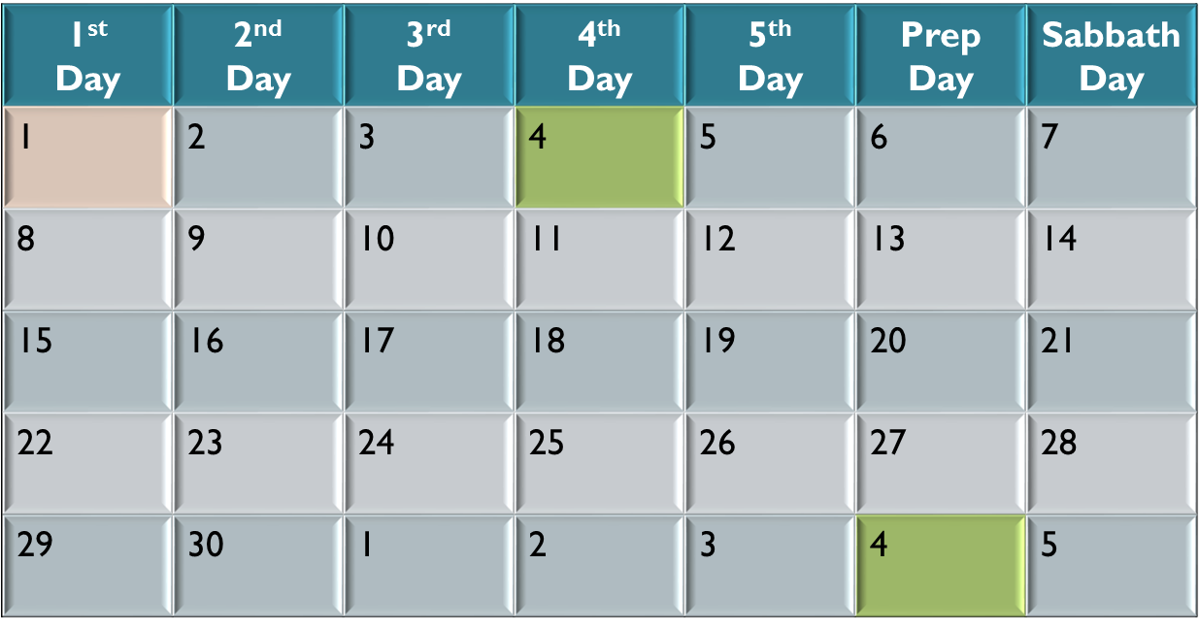
Festal Month & Lunar Month
Given at Creation
R
E
V
I
E
W
The lunar month was always
3 days behind Yahuah’s
set-apart month start.
The 1st day of the 1st Lunar Cycle.
The 1st day of the 1st week!
The 1st day of the 1st month!
The 1st day of the 1st year!
The 1st day of the 2nd Lunar Cycle.
Notes:
64n June 20th

Slide 17

R
E
V
I
E
W
#3 Lunar Months Today
Sidereal month: 27.3 days
Synodic month: 29.5 days
17
4 SLIDES

Slide 18


Yahuah’s Special Significant Numbers
The Scriptures speak of some very special numbers which
are significant for Yahuah’s purposes. Some examples are:
1 2 3 4 7 10 12 24 30 40 42
50 70 100 120 400 430 490 1000
And … 144,000!
Consider these numbers: ~27.3 & ~29.5
Are they part of Yahuah’s numbering system?
R
E
V
I
E
W
The Scriptures speak of some very special numbers which are significant for Yahuah’s purposes. Some examples are:
1 (One Elohim)
2 (Union/Two Sides)
3 (Completeness to a lesser degree than 7)
4 (Love to Yahuah)
6 (Human weakness/Love to Mankind)
7 (Sabbath/Festivals / Perfection)
      8 (New Beginnings)
10 (Completeness)
http://www.biblestudy.org/bibleref/meaning-of-numbers-in-bible/3.html
Biblical Meaning of Numbers (July 20/18)
1 - 2 - 3 - 4 - 5 - 6 - 7 - 8 - 9
10 - 11 - 12 - 13 - 14 - 15 - 16 - 17
18 - 19 - 20 - 21 - 22 - 23 - 24 - 25
27 - 28 - 29 - 30 - 31 - 33 - 34 - 40
42 - 44 - 50 - 65 - 70 - 120 - 153 - 200
390 - 400 - 430 - 444 - 490 - 666 - 1000
The Meaning of Numbers: The Number 3
The number 3 is used 467 times in the Bible. It pictures completeness, though to a lesser degree than 7. The meaning of this number derives from the fact that it is the first of four spiritually perfect numerals (the others being 7, 10 and 12). The 3 righteous patriarchs before the flood were Abel, Enoch and Noah. After the deluge there was the righteous "fathers" Abraham, Isaac and Jacob (later renamed Israel).
There are 27 books in the New Testament, which is 3x3x3, or completeness to the third power.Jesus prayed three times in the Garden of Gethsemane before His arrest. He was placed on the cross at the 3rd hour of the day (9 a.m.) and died at the 9th hour (3 p.m.). There were 3 hours of darkness that covered the land while Jesus was suffering on the cross from the 6th hour to the 9th hour. Three is the number of resurrection. Christ was dead for three full days and three full nights, a total of 72 hours, before being resurrected on Saturday, April 8, just before sunset.
Appearances of the number three
There were only three individuals who witnessed Jesus' transfiguration on Mount Hermon. Those who saw Jesus' glory on the mount were John, Peter and James.
The apostle Paul was an exceptionally well educated person. In three different occasions he quotes directly from Greek poets (Acts 17:28, 1Corinthians 15:33 and Titus 1:12). He also was privileged to visit the location of God's throne, which is in the third heaven (2Corinthians 12:2 - 4).
Notes:
http://applygodsword.com/what-does-the-number-three-mean-in-the-bible/
prophesying what’s going to happen and using specific numbers repeatedly, such as the number three; The number three in relation to the gospel of Jesus Christ at minimum proves that God is in control of all these events that took place which resulted in our salvation.
Jesus was 30 years old when he started his public ministry.
• Jesus was tempted 3 times in the desert by Satan.
• Peter, James, and John were the three disciples with Jesus in the Garden of Gethsemane who were in his inner circle.
• The disciples failed to stay awake three times in the Garden of Gethsemane.
• Peter denied Jesus three times.
• In John 21 when Jesus reinstates Peter, he asks him 3 times if Peter loves him.
• It says in Mark 15:25 that it was the third hour of the day when Jesus was crucified.
• The Holy Spirit’s anointing at Pentecost according to Acts 2:15 happened at the third hour of the day.
• Jesus rose from dead on the third day.

Slide 19
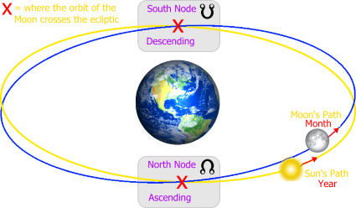
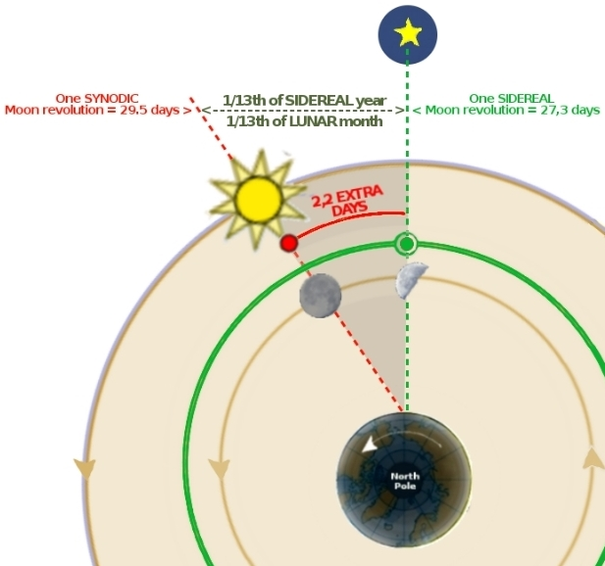
1) Sidereal Month:
(aligns with the stars)
The time it takes for the moon to complete one orbit of Earth;
an average of 27.3 days.
2) Synodic Month:
(aligns with the sun)
The time it takes for
the moon to reach the same visual phase; an average of 29.5 days or 29 phases.
R
E
V
I
E
W

Slide 20



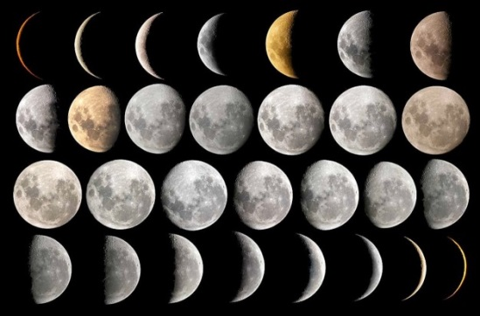
Attention all
“moon” calendars!

Slide 21
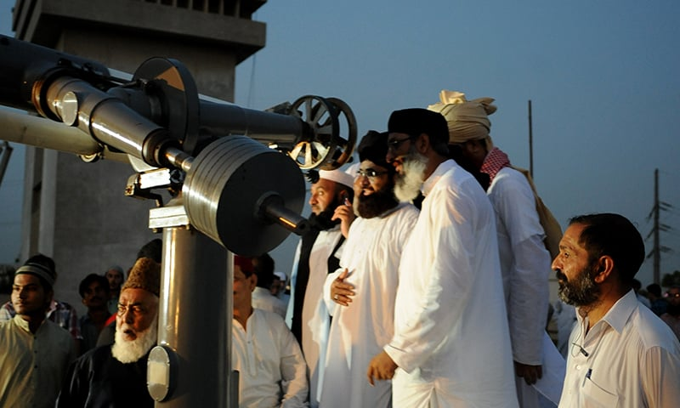
Rabbis Festal Lunar Month
Which month is their
true lunar month?
1) Sidereal Month
2) Synodic Month
Most feast calendars that use the moon month - mark the new moon day according to a particular moon phase, not the completion of the Sidereal Month cycle.
R
E
V
I
E
W
Notes:
July 18/18: The sidereal month is the time it takes to make one complete orbit around Earth with respect to the fixed stars. It is about 27.32 days. The synodic month is the time it takes the Moon to reach the same visual phase. This varies notably throughout the year, but averages around 29.53 days.
Bullet #3: Man’s stretching the synodic month from the sidereal month can be researched through the Metonic cycle – per Tim – Aug 1/18
For astronomy and calendar studies, the Metonic cycle or Enneadecaeteris (from Ancient Greek: ἐννεακαιδεκαετηρίς, "nineteen years") is a period of very close to 19 years that is nearly a common multiple of the solar year and the synodic (lunar) month. (wikipedia)
Metonic cycle, in chronology, a period of 19 years in which there are 235 lunations, or synodic months, after which the Moon’s phases recur on the same days of the solar year, or year of the seasons. The cycle was discovered by Meton (fl. 432 bc), an Athenian astronomer. Computation from modern data shows that 235 lunations are 6,939 days, 16.5 hours; and 19 solar years, 6,939 days, 14.5 hours.
This 19-year lunar cycle became known as the Metonic cycle, and was the basis for the Greek calendar until the Julian calendar was introduced in 46 BC. Since 12 lunar months equal 354.367 days, about 11 days less than a solar year, an additional lunar months were added to synchronize the cycle.
Who came up with 365 days/year? Certain difficulties arose, however, because of the inherent incompatibility of lunar and solar years. To solve this problem the Egyptians invented a schematized civil year of 365 days divided into three seasons, each of which consisted of four months of 30 days each.

Slide 22

What is your answer to this question?
1. When did Yahuah change His mind and
give His people a “new”
set-apart month with ~27.3 days,
or ~29.5 days/month?
2. Answer: Neither ~27.3 or ~29.5
fit the requirements
to be part of Yahuah’s numbering system?
R
E
V
I
E
W
Why?
Because of
a 19 year cycle known as Metonic.

Slide 23
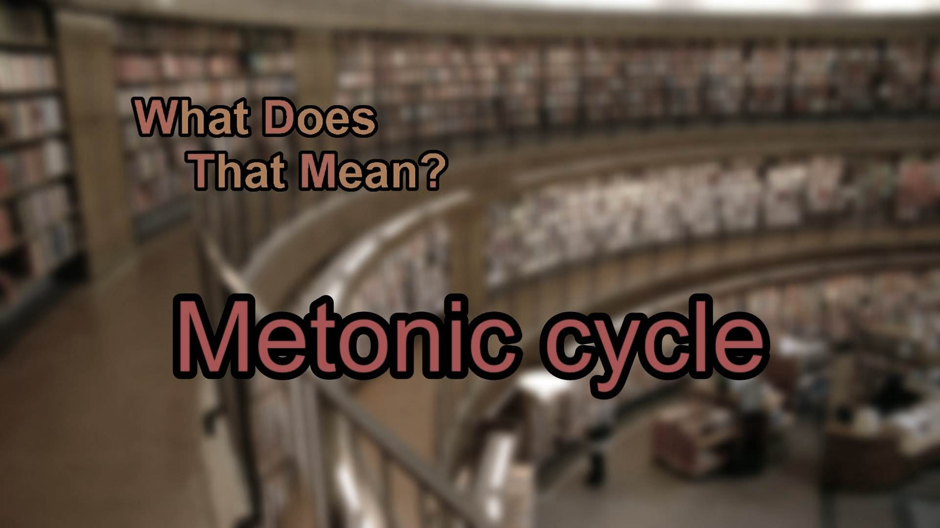
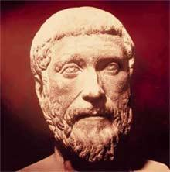

Meton ~
A Greek
astronomer
introduced the
around 432 BC (7 of the 19 years had 13 months).
The Babylonians had already been utilizing the
same 19 year cycle calendar since the 6th century BC
Notes:
The Metonic cycle (or Enneadecaeteris from Ancient Greek: ακαιδεκαετηρίς, "nineteen years") is a period of very close to 19 years that is nearly a common multiple of the solar year and the synodic (lunar) month. The Greek astronomer, Meton of Athens, (fifth century BC) observed that a period of 19 years is almost exactly equal to 235 synodic months. The difference between the two periods of 19 years and 235 synodic months is only a few hours…

Slide 24

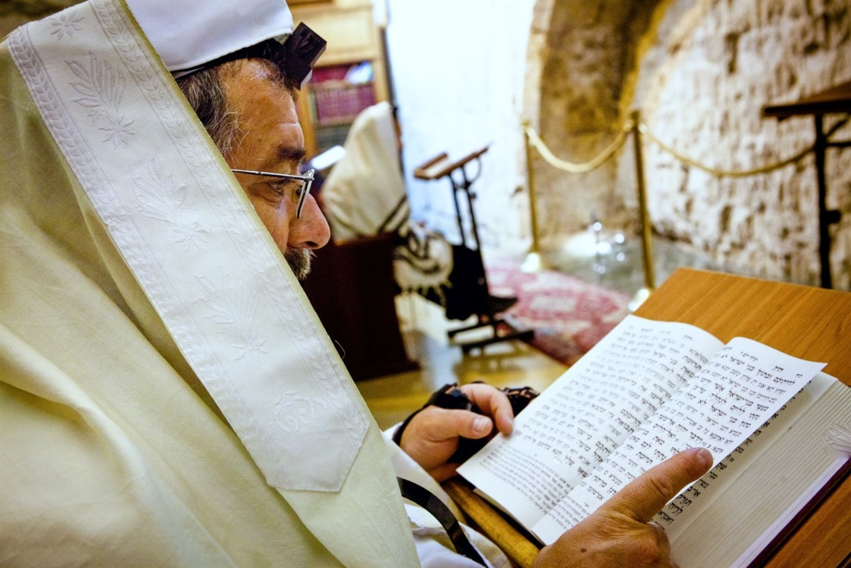


Lunar Roots of the Jewish Calendar
The Jews adopted the Babylonian calendar dates from the period of their Babylonian Exile in the 6th century B.C.
This 19-year lunar cycle became known
as the Metonic cycle, and was the basis
for the Greek calendar until the Roman Julian calendar was introduced in 46 BC.
This calendar has deep roots in several pagan nations all requiring a 13th month.
Notes:
7 years have 13 months.

Slide 25
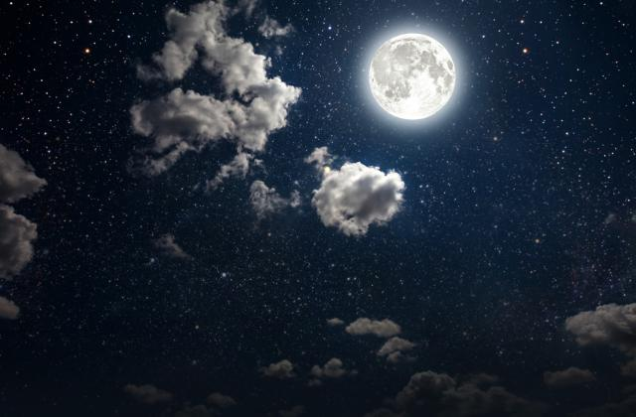
Back to the Moon …
R
E
V
I
E
W
Because the full moon
reigns in the sky all
night long for only
one night
each lunar month …
The moon has nothing to do
with the separation of the
day and night seasons!
But …
25
Notes:
It’s only the full moon that that rises in the east as the sun is setting in the west and reigns in the sky all night long. That means the moon is up all night long only one night each month.

Slide 26
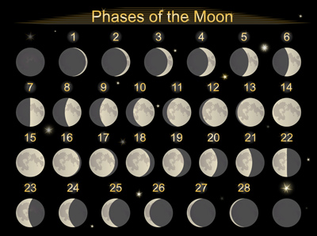
H3391 <yerach>
Can the phases of the moon separate
or rule Yahuah’s festal months?
It depends on who you ask!
It depends on “which” phase!
It depends on Hebrew definitions!
Will H3391 provide answers?

Slide 27

[#2] H3391 MOON <yerach>
Taking a Closer Look
This means: the cycle or lunation of the moon – labeled as a month.
References Found:
Strong’s: 2
Englishman’s: 13!
Verb
Notes:
June 19/17
47

Slide 28
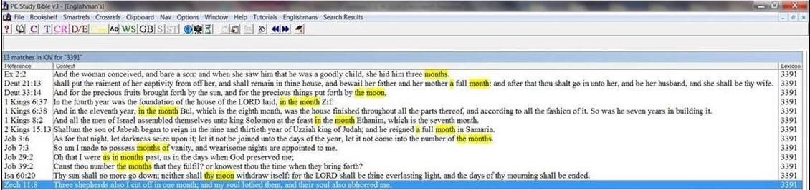
Englishman’s Concordance H3391
Strong’s: “moon” or “moons” | Englishman’s: by Hebrew Word #
2. H3391 = 2 listings <yerach> | 2. H3391 = 13 listings <yerach> (11 extra listings) 2 listings are translated as moon 11 listings are translated as month
R
E
V
I
E
W

Slide 29
H3391 MOON <yerach> [as a Verb]
R
E
V
I
E
W
[Strong’s] MOON - H3391 yerach (yeh'-rakh); from an unused root of uncertain signification; [1] a lunation,
i.e. [2] month: KJV – month [11 times], moon [2 times].
[BDB] H3391 yerach – a month (lunar cycle),
the moon [2 times].
a) a month
b) a calendar month [11 times].
“Lunation”
will be
defined soon.

Slide 30
Mapping the Topics for H3391 Part 2
1. Creation Patterns
5. Definitions: Moon
Perfection, Devastation, Restoration
Lunation, Lunar, Leuk
6. Lucifer & Leuk
2. Creation Months
1st Day – 30 day month
4th Day – 30 day month
7. Defs: Family Words
H3391-3394; H3399-3405
3. Lunar Months
8. H3391 Scriptures (13)
Sidereal – 27.3 day month
Synodic – 29.5 day month
11 as Month; 2 as Moon
4. Beings of Light
9. Puzzle Solving
Yahuah & Lucifer
Psa 81:3; Num 10:10; Deut 21:13

Slide 31
Yahuah is light
Lucifer is given light
#4 Beings of Light
4 SLIDES

Slide 32
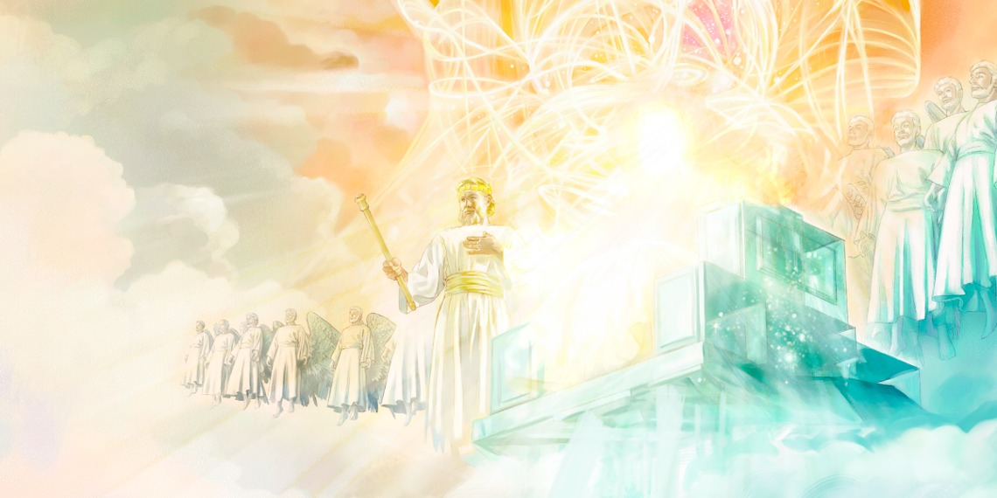
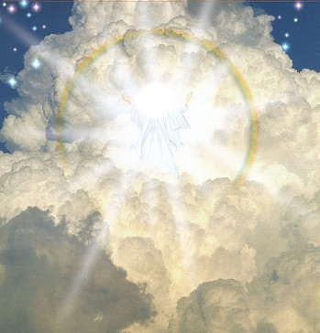
What About “LIGHT” in Yahuah?
1 Tim 6:15-16 He who is the blessed and only Potentate, the
Sovereign of sovereigns and Master of masters, 16 who alone has immortality, dwelling in unapproachable light, whom no
man has seen or can see.
NKJV [with use of Sacred Titles]
1 John 1:5 This then is the message which we have heard of him, and declare unto you, that
Yahuah is light, and in him is
no darkness at all. KJV
The Creator, Who is LIGHT and created light, dwells in
unapproachable LIGHT!

Slide 33

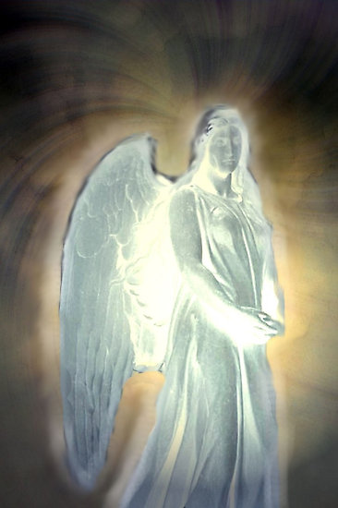
What About “Light” in Lucifer?
Isa 14:12 … Lucifer, son of the morning! KJV
Lucifer - H1966; heylel; from H1984
(in the sense of brightness); the morning-star: KJV - lucifer (the king of Babylon).
  H1984 halal; a primitive root; to be clear
  (orig. of sound, but usually of color); to shine; hence, to make a show, to boast; and thus to be (clamorously) foolish; to rave; causatively, to celebrate; also to stultify.
There was a sense of brightness around Lucifer.

Slide 34
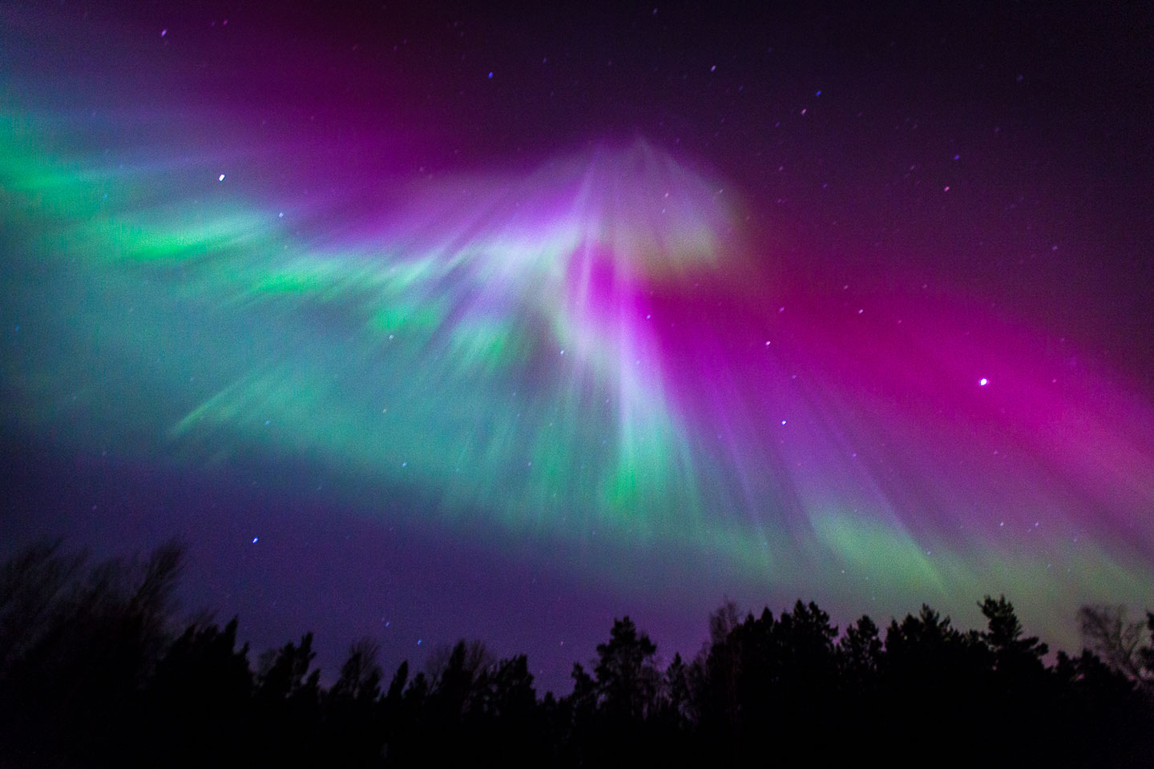
Who gave “who” “light”?
Soon we’ll
see how these
concepts
connect to
“leuk.”
The Creator, is LIGHT!
Lucifer means: light, brightness …
The Creator, is the Only One that can give
Lucifer his light and brightness.

Slide 35
Lunation lunar leuk [Introduction]
#5 Definitions: Moon
35
4 SLIDES

Slide 36

Understanding H3391
H3391: is the root word for the set of family words between H3391-H3394.
Note:
The definition of the root word is the most important.
The 1st definition of H3391 is: lunation [or the cycle] – not “moon” and not “month.”
“Lunation” is always linked to the “moon.”
The sun and stars have cycles, but they are not called “lunations.”

Slide 37

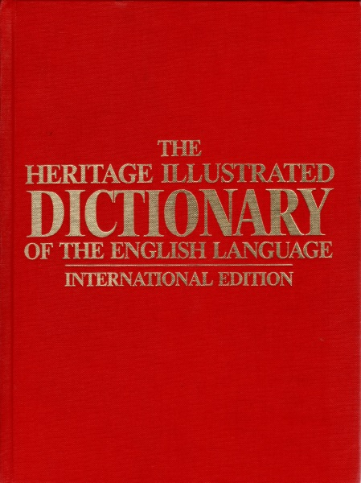

Understanding “Lunation”
From: The Heritage Illustrated Dictionary of the English Language.
Lunation: The time elapsing between two successive new moons, averaging 29 days, 12 hrs., 44 min., 28 sec. From Latin luna, moon. See lunar.
Defines a Synodic Month

Slide 38

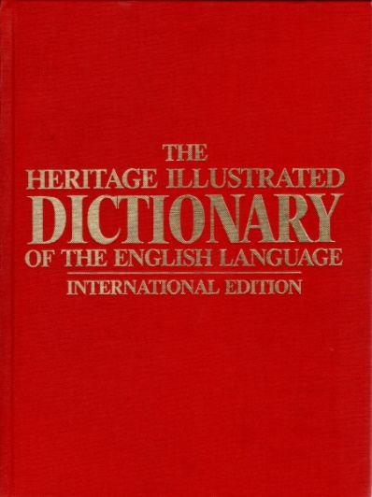

Understanding “Lunar”
From: The Heritage Illustrated Dictionary of the English Language.
Lunar: of, involving, caused by, or affecting the moon. Measured by the revolution [cycle] of the moon:
a lunar month; a lunar year. [Then it says:]
See leuk- in Appendix.*
The word “leuk” will be examined shortly.

Slide 39

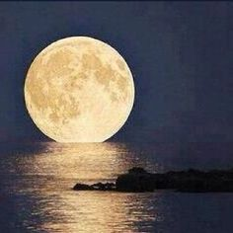
Understanding “Leuk’s” Connection to Lunar
Note: “Leuk” is connected to both “lunar” [literal moon]
and “lunation” [moon’s cycle]. (See slides #37 - #38.)
The MOON has no “light” of its own.
(Remember Isa 13:10 re: “masculine moon.”)
The sun gives the moon its brightness.
But, the moon has always had its own
lunar cycle since creation.
This cycle began with a perfect 30 day length.
Question: Was it Yahuah’s purpose to allow Sidereal and Synodic months of different lengths? Has Yahuah designed a “built-in” test
for every religious calendar?
Notes:
Job 25:5 Behold even to the moon, and it shineth not; yea, the stars are not pure in his sight.
[Behold even to the moon, and it shineth not] Or, behold even the moon shineth not. That is, in comparison with God it is dark and obscure. The idea is, that the most beautiful and glorious objects become dim and fade away when compared with him. So Jerome renders it, Ecce luna etiam non splendet. The word here rendered "shineth" ya'ahiyl (OT:166) frequently means to pitch or remove a tent, and is a form of the word 'ohel (OT:168) uniformly rendered tent or tabernacle. Some have supposed that the meaning here is, that even the moon and the stars of heaven-the bright canopy above-were not fit to furnish a tent or dwelling for God. But the parallelism seems to demand the usual interpretation, as meaning that the moon and stars faded away before God. The word 'ohel (OT:168) derives this meaning, according to Gesenius, from its relation to the word haalal (OT:1984), to be clear or brilliant, from the mutual relation of the pe-'aleph and 'ayin-`ayin verbs. The Arabic has the same meaning.
[Yea, the stars are not pure in his sight] That is, they are not bright in comparison with him. The design is to show the glory of the Most High and that nothing could be compared with him; see the notes at Job 4:18. (from Barnes' Notes, Electronic Database. Copyright (c) 1997 by Biblesoft)
Job 25:1-6 God exalted and man abased
Bildad is to be commended here for two things:-
1. For speaking no more on the subject about which Job and he differed. Perhaps he began to think Job was in the right, and then it was justice to say no more concerning it, as one that contended for truth, not for victory, and therefore, for the finding of truth, would be content to lose the victory; or, if he still thought himself in the right, yet he knew when he had said enough, and would not wrangle endlessly for the last word. Perhaps indeed one reason why he and the rest of them let fall this debate was because they perceived that Job and they did not differ so much in opinion as they thought: they owned that wicked people might prosper a while, and Job owned they would be destroyed at last; how little then was the difference! If disputants would understand one another better, perhaps they would find themselves nearer one another than they imagined.
2. For speaking so well on the matter about which Job and he were agreed. If we would all get our hearts filled with awful thoughts of God and humble thoughts of ourselves, we should not be so apt as we are to fall out about matters of doubtful disputation, which are trifling or intricate.
Two ways Bildad takes here to exalt God and abase man:-
I. He shows how glorious God is, and thence infers how guilty and impure man is before him, v. 2-4. Let us see then,
1. What great things are here said of God, designed to possess Job with a reverence of him, and to check his reflections upon him and upon his dealings with him:
(1.) God is the sovereign Lord of all, and with him is terrible majesty. Dominion and fear are with him, v. 2. He that gave being has an incontestable authority to give laws, and can enforce the laws he gives. He that made all has a right to dispose of all according to his own will, with an absolute sovereignty. Whatever he will do he does, and may do; and none can say unto him, What doest thou? or Why doest thou so? Dan 4:35. His having dominion (or being Dominus - Lord) bespeaks him both owner and ruler of all the creatures. They are all his, and they are all under his direction and at his disposal. Hence it follows that he is to be feared (that is, reverenced and obeyed), that he is feared by all that know him (the seraphim cover their faces before him), and that, first or last, all will be made to fear him. Men's dominion is often despicable, often despised, but God is always terrible.
(2.) The glorious inhabitants of the upper world are all perfectly observant of him and entirely acquiesce in his will: He maketh peace in his high places. He enjoys himself in a perfect tranquillity. The holy angels never quarrel with him, nor with one another, but entirely acquiesce in his will, and unanimously execute it without murmuring or disputing. Thus the will of God is done in heaven; and thus we pray that it may be done by us and others on earth. The sun, moon, and stars, keep their courses, and never clash with one another: nay, even in this lower region, which is often disturbed with storms and tempests, yet when God pleases he commands peace, by making the storm a calm, Ps 107:29; 65:7. Observe, The high places are his high places; for the heaven, even the heavens, are the Lord's (Ps 115:16) in a peculiar manner. Peace is God's work; where it is made it is he that makes it, Isa 57:19. In heaven there is perfect peace; for there is perfect holiness, and there is God, who is love.
(3.) He is a God of irresistible power: Is there any number of his armies? v. 3. The greatness and power of princes are judged of by their armies. God is not only himself almighty, but he has numberless numbers of armies at his beck and disposal,-standing armies that are never disbanded,-regular troops, and well disciplined, that are never to seek, never at a loss, that never mutiny,-veteran troops, that have been long in his service,-victorious troops, that never failed of success nor were ever foiled. All the creatures are his hosts, angels especially. He is Lord of all, Lord of hosts. He has numberless armies, and yet makes peace. He could make war upon us, but is willing to be at peace with us; and even the heavenly hosts were sent to proclaim peace on earth and good will towards men, Luke 2:14.
(4.) His providence extends itself to all: Upon whom does not his light arise? The light of the sun is communicated to all parts of the world, and, take the year round, to all equally. See Ps 19:6. That is a faint resemblance of the universal cognizance and care God takes of the whole creation, Matt 5:45. All are under the light of his knowledge and are naked and open before him. All partake of the light of his goodness: it seems especially to be meant of that. He is good to all; the earth is full of his goodness. He is Deus optimus-God, the best of beings, as well as maximus-the greatest: he has power to destroy; but his pleasure is to show mercy. All the creatures live upon his bounty
(from Matthew Henry's Commentary on the Whole Bible: New Modern Edition, Electronic Database. Copyright (c) 1991 by Hendrickson Publishers, Inc.)

Slide 40
This section may have a huge surprise!
#6 Lucifer & Leuk
40
10 SLIDES

Slide 41
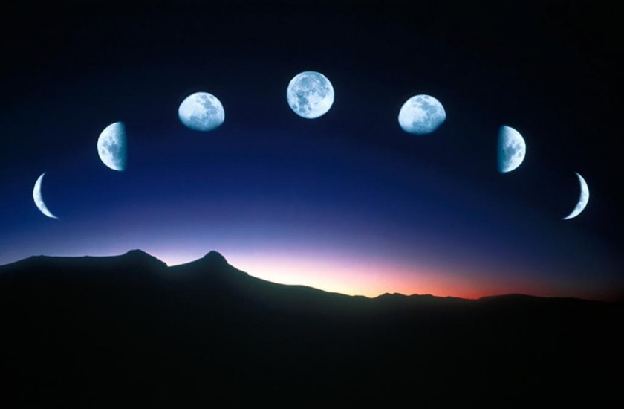
In this next section, we’ll examine what
the definitions of “lunation” & “lunar”
have to do with “leuk”?

Slide 42


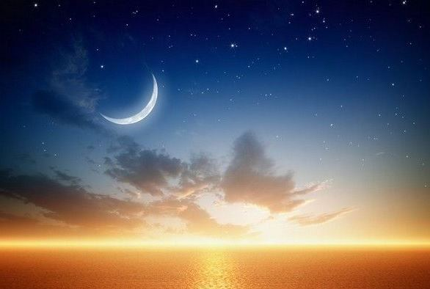
Understanding “Leuk’s” Connection to Lunar
R
E
V
I
E
W
Reminder:
“Leuk” is connected to “lunar”
[the literal moon]
and “lunation”
[the moon’s cycle].
Notes:
73n June 20th

Slide 43

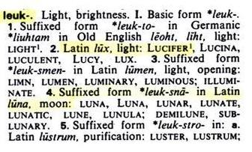
Definition for: “Leuk” [from “lunar”]
From the Appendix:
The Heritage Illustrated Dictionary of the English Language.
Note:
In Latin, “leuk” connects both Lucifer [lux] and
Moon [lunar]
to the
Synodic Month!

Slide 44

Understanding “Leuk’s” Connection to Lucifer
From: The Heritage Illustrated Dictionary of the English Language.
Leuk – (comes from the words lunar & lunation) meaning “light” or “brightness.”
In Latin the word
“leuk” is lux,
meaning: Lucifer!
Lucifer and the
Moon connect through the words:
Light
Whiteness &
Brightness!

Slide 45


Lucifer’s Loss of Perfection
Lucifer rebelled! Refusing to repent,
he was cast out of heaven and became
the ruler of darkness of this world
and the dark prince of the air.
His new serpent names:
Satan & Devil.
He will never again be an angel of light
even though he can make it appear that way (2 Cor 11:14).

Slide 46

“Leuk” Comparisons of Lucifer to the Moon
The MOON has no “light.”
(Isa 13:10)
The moon’s light is a reflection from the s-u-n.
Is there a connection between
these two statements?
Lucifer had no “light.”
His light came from
“the S-o-n.”

Slide 47


Review of Leuk Definition
Note the comparisons for Leuk!
Leuk – The suffixed form in Old English is light:
1. In Latin, light = Lucifer.
2. Suffixed form of lumen in Latin =
luminous; illuminate.
3. Suffixed form of luna, in Latin =
moon: lunar, lunate, lunatic, … etc.!
An investigation on “luna” will follow shortly.

Slide 48
What does all of this have to do with
H3391’s “lunation cycle” & H3394’s “literal moon”?
Moon = lunar, lunation, leuk & [borrowed] brightness.
Is the MOON connected to Satan through “darkness”?
A Thought to Ponder:
Does it sound like this
lunar lunation [cycle]
would have the authority to commence Yahuah’s
set-apart months and
yearly worship statutes?
Will “Luna” know?
The moon is dark until it receives
light reflected
from the sun.
Lucifer’s light came from “the Son.”

Slide 49


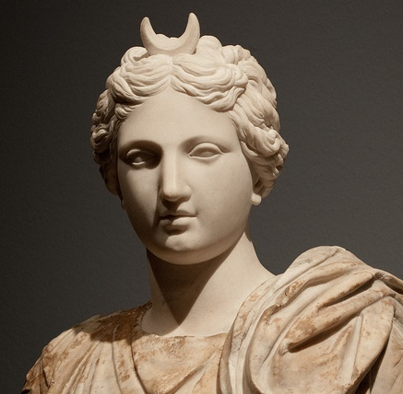
Scriptural “Luna” Comparisons
Luna Family Words (G4582; G4583):
G4583 seleniazomai; middle voice or passive from a presumed derivative of G4582; to be moon-struck, i.e. crazy: KJV - be a lunatic.
Matt 4:24 And his fame went throughout all Syria: and they brought unto him all sick people … and those which were lunatick …
Matt 17:15 Yahusha, have
mercy on my son: for he is
lunatick, and sore vexed …
G4582 selene; from selas (brilliancy; probably akin to the alternate of G138, through the idea of attractiveness);
the moon.
Selene
Greek Moon
Goddess

Slide 50

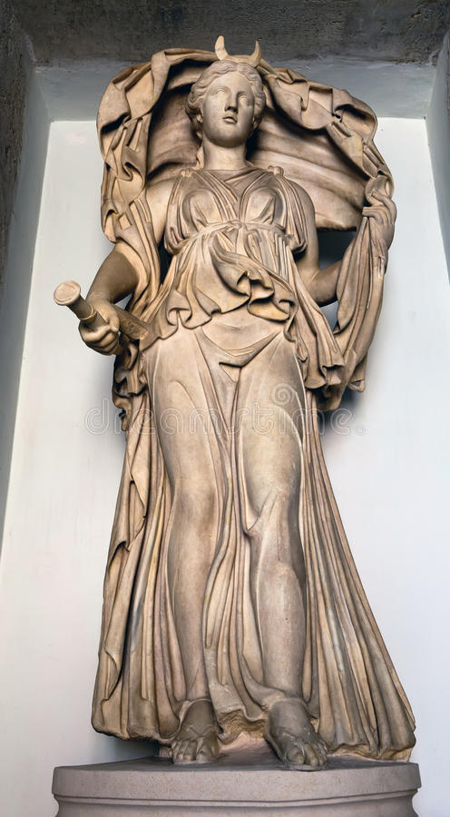
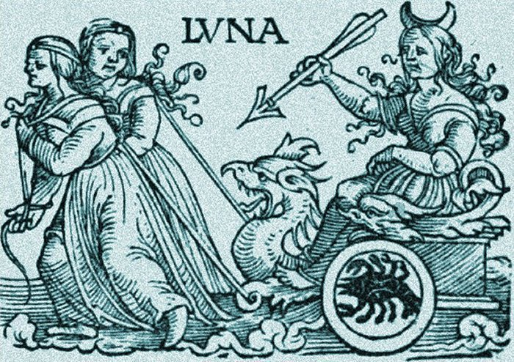
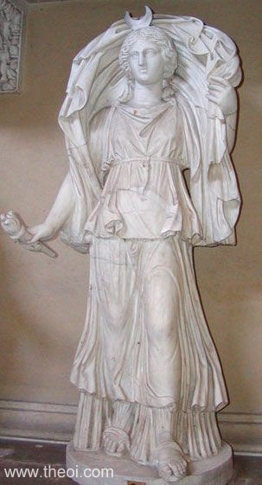
Mystic “Luna” Comparisons
“Luna” (Roman mythology)
the goddess of the Moon; counterpart of Greek Selene.
Selene
Vatican
Museum
Are Luna & Selene involved
with Yahuah’s festal months?

Slide 51
#7 Definitions: Family Words
H3391 – H3394
(Lunation cycle & Literal Moon)
H3399 – h3405
(contention & fall of Jericho)
9 SLIDES

Slide 52
Next: comparing definitions of Hebrew Family Words …
a. H3391 – H3394 (verb & noun)
b. Between H3399 & H3405
(descriptive definitions leading up to
Jericho, the moon worshipping city)
Will there be another connection between
the lunar/moon and Lucifer/Satan?

Slide 53
Understanding H3391
R
E
V
I
E
W
H3391: is the root word for the set of family words between H3391-H3394.
Note:
The definition of the root word is the most important.
The 1st definition of H3391 is: lunation [or the cycle] –
not “moon” and not “month.”
“Lunation” is always linked to the “moon.”
The sun and stars have cycles, not “lunations.”

Slide 54


H3391 MOON
<yerach> is the primitive root of:
H3392, H3393 &
H3394 MOON
<yareach>.
A Comparison of Family Words
H3392: Yerach;
name of an Arabian patriarch.
H3393: yerach (Aramaic);
for 12 months; or Adar the 12th month.
Note: These last two Hebrew words are connecting to the “moon” family words of <yerach> and <yareach>.
Remember this for the study on H2320.

Slide 55
Family Words After H3394
H3399: hurl; turn over
H3400: thrown of Yahuah
H3401: contentious; adversary
H3402: same as H3401, a name meaning contentious.
H3403: from H3401; contend
H3404: from H3384; to throw
H3405: from H3394; Jericho (a contentious city)
Note: General definitions give the picture of
“something contentious and being thrown over,
like Jericho, the moon worshipping city.”

Slide 56
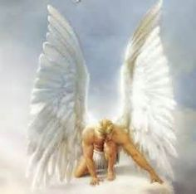
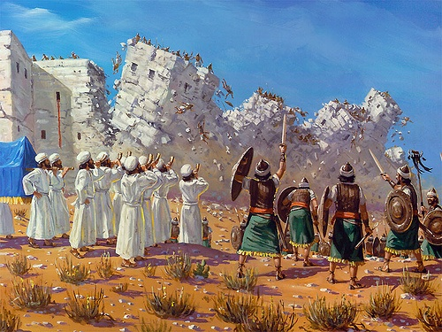
“Leuk” Connects the Family Words
H3391-3394 meanings: lunation, literal moon, & leuk
[leuk = Lucifer. Lucifer & the moon both had borrowed brightness/whiteness].
H3399-3405 meanings:
very contentious & adversarial
[like Lucifer] – needing to be thrown down like Jericho.

Slide 57
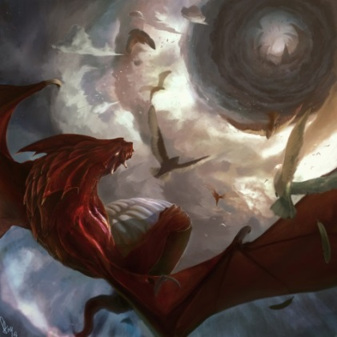
Lucifer & Jericho Cast Down
H3391 & H3394: The meanings of lunation and the literal moon connect to leuk.
Leuk connects to Lucifer – he was cast down from heaven.
H3399 - H3405: The meanings of contention linking to Jericho, as a contentious adversary & moon worshipping city.
Jericho had to be thrown over before
Joshua entered further into Canaan.
Endtime Application: Before entering the Heavenly Canaan, all sacred regard for the moon to command worship statutes must be cast down – or placed “under the foot” (Rev 12:1).

Slide 58

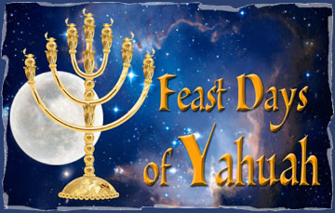

What’s Wrong With This Picture?

Slide 59

The “moon” has been cast down!
The “moon” is not in charge of calculating the
The moon is “under the foot”!

Slide 60
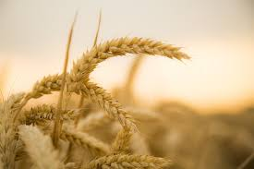

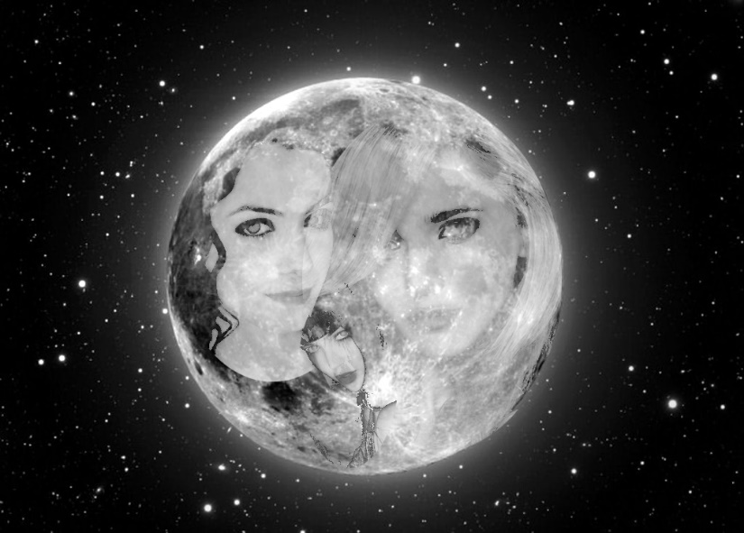
Wiccan’s and Moon Worship
Who has the authority to change Yahuah’s mandate for the moon to commence festal
months?
The moon’s ordained job description is for special agricultural ordinances
to bless the earth
and mankind.
Luna ?
Selene ??
Satan ???
Pagans have always worshipped the moon!

Slide 61
11 Scriptures use month
2 scriptures use moon
#8 H3391 Scriptures
61
6 SLIDES

Slide 62
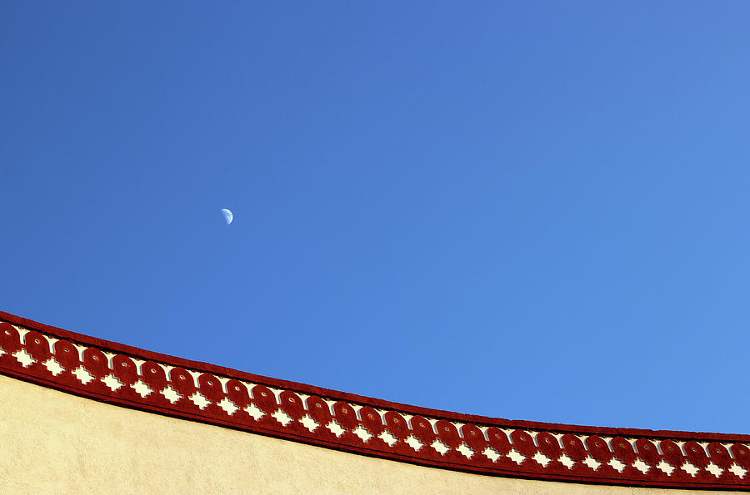
H3391 in “13” Scriptures
H3391 is used 2 times, translated as moon.
Yahuah’s festal month
has 30 days.
Yahuah’s month renews & rebuilds after 30 days.
H3391 is used 11 times, translated as month;
3 times a pagan month is named.
The moon/month has a lunation cycle of 27.3 days.
For 3300 years the moon was renewed after 30 days – but not anymore! (H2320 will explain this point in detail.)

Slide 63

H3391 “month” Verses from Englishman’s
Strong’s lists only 2 Scriptures for H3391 using the word moon. (Deut 33:14 [a vs. on agricultural ordinances]; Isa 60:20.)
Englishman’s lists the following 11 Scriptures for H3391
using the word month.
Exo 2:2 “three months”
Deut 21:13 “a full month”
1 Kings 6:37 “month of Zif”
1 Kings 6:38 “8th month of Bul”
1 Kings 8:2 “month of Ethanim”
2 Kings 15:13 “a full month”
Job 3:6 “number of months”
Job 7:3 “months of vanity”
Job 29:2 “as in months past”
Job 39:2 “number the months”
Zech 11:8 “in one month”
Will any if these verses commence the month?

Slide 64

H3391 <yerach> as MONTH / 30 days
Exo 2:2 And the woman conceived, and bare a son: and when she saw him that he was a goodly child, she hid him three months. [These patterns of 30 days would
be counted by lunation cycle.]
Deut 21:13 And she shall put the raiment of her captivity from off her, and shall remain in thine house, and bewail her father and her mother a full month:
[To be addressed in detail soon.]
1 Kings 6:37 In the fourth year was the foundation of the house of Yahuah laid, in the month Zif:
[Name of month.]
1 Kings 6:38 And in the eleventh year, in the month Bul, which is the eighth month … [Name of month.]
1 Kings 8:2 And all the men of Israel assembled themselves unto king Solomon at the feast in the month Ethanim, which is the seventh month [H2320]. [Name of month.]

Slide 65

H3391 <yerach> as MONTH / __ days?
2 Kings 15:13 [772 BC] Shallum the son of Jabesh began to reign in the nine and thirtieth year of Uzziah king of Judah; and he reigned a full month
[30 days] in Samaria.
Job 3:6 [~1520 BC] As for that night, let darkness seize upon it; let it not be joined unto the days of the year, let it not come into the number of the months.
Job 7:3 So am I made to possess months of vanity, and wearisome nights are appointed to me.
Job 29:2 Oh that I were as in
months past, as in the days when
Yahuah preserved me;
Job 39:2 Canst thou number the months that they fulfil? or knowest thou the time when they bring forth?
[Fertility cycles.]
Zech 11:8 [487 BC] Three [vs. 17 idol / false] shepherds also I cut off in one month …
[How many days would the month be?]
Notes:
Feb 17/17: Zech 11 is the only verse that is after 700 BC. (at 457 BC) July 18/18: however, the context is about idol worshippers, or false shepherds in vs 17 … obviously they were following the lunar month … this verse has reference to Hos 5:11 (780 BC) before the sundial event and scattering of the northern kingdom.

Slide 66
H3391 <yerach> as MOON (ONLY 2 References)
#1 AN AGRICULTURE REFERENCE to the MOON’s Lunation Cycle (an action)
Deut 33:14 And for the precious fruits brought forth by the sun, and for the precious things put forth by the MOON. [H3391- ordinances of lunation cycle.]
#2 A PROPHETIC REFERENCE TO the MOON’s Lunation Cycle (an action)
Isa 60:20 Thy sun shall no more go down; neither shall thy MOON [H3391] withdraw itself [moon’s lunation cycle]: for Yahuah shall be thine everlasting light, and the days of thy mourning shall be ended.
Note: Between these two [H3391] verses only one is a Torah reference using “moon.” Question: Is the context for the chapter in Deut 33:
a) the beginning of the month with a lunar cycle?
b) the beginning of the month on the 1st day of a set-apart month?
c) or neither?
Isa 60:20 will be addressed in a future study in detail.

Slide 67

The Lunar Month (a Review)
The Lunar month [H3391] was designed for agricultural ordinances.
However the ordinances of the lunar month were ex-changed by sinful man and substituted for the commencement of pagan worship statutes; giving homage to the pagan moon god.
After the sundial event [~700 BC] the lunation cycle changed from 30 days/month to an average of 27.3 [Sidereal] days/month.
The Metonic Cycle stretched the lunar month to about 29.5 [Synodic] days/month!!
[This is from “phase to phase” which extends beyond the completed cycle.]
When H3391 is used … it is usually connected to the
moon’s original creation week lunar month of 30 days.
At creation, both types of months had 30 days each.
How can
we know
for sure?
Notes:
Bullet #3: Man’s stretching the synodic month from the sidereal month can be researched through the Metonic cycle – per Tim – Aug 1/18
For astronomy and calendar studies, the Metonic cycle or Enneadecaeteris (from Ancient Greek: ἐννεακαιδεκαετηρίς, "nineteen years") is a period of very close to 19 years that is nearly a common multiple of the solar year and the synodic (lunar) month. (wikipedia)
Metonic cycle, in chronology, a period of 19 years in which there are 235 lunations, or synodic months, after which the Moon’s phases recur on the same days of the solar year, or year of the seasons. The cycle was discovered by Meton (fl. 432 bc), an Athenian astronomer. Computation from modern data shows that 235 lunations are 6,939 days, 16.5 hours; and 19 solar years, 6,939 days, 14.5 hours.
This 19-year lunar cycle became known as the Metonic cycle, and was the basis for the Greek calendar until the Julian calendar was introduced in 46 BC. Since 12 lunar months equal 354.367 days, about 11 days less than a solar year, an additional lunar months were added to synchronize the cycle.
Who came up with 365 days/year? Certain difficulties arose, however, because of the inherent incompatibility of lunar and solar years. To solve this problem the Egyptians invented a schematized civil year of 365 days divided into three seasons, each of which consisted of four months of 30 days each.

Slide 68
Deuteronomy 21:13 numbers 10:10 psalm 81:3
#9 Puzzle Solving
68
10 SLIDES

Slide 69
Now that we know …
H3391 has the “verb/action” meaning of the moon’s cycle;
The moon month from creation also started out with 30 days;
Lunar & lunation connect to the words Lucifer and moon …
We are now ready to examine the next point.
Question: Does H3391 as the “moon month” ever refer to Yahuah’s 30 day creation month? Why?
Because the Englishman’s Concordance lists
H3391 as “month” [rather than moon’s lunation] in
Deut 21:13. Let’s examine this tricky problem.

Slide 70


Are These Scriptures Synonymous?
Ps 81:3 – Blow the trumpet in the
new moon … (H2320)
Num 10:10 – Blow the trumpet in the beginning of the month. (H2320)
Deut 21:13 – Bewail her family for
a full month. (H3391)
Is this H3391 month the same as
Yahuah’s set-apart month?
Do these 3 Scriptures support the “[new] moon-month”
being in alignment with Yahuah’s set-apart month?

Slide 71


Scrutinizing Deut 21:13
This Torah verse is often used to prove that a
lunar month is identical to Yahuah’s original set-apart
H2320 month for feast worship statutes.
Deut 21:13 And she shall put the raiment of her captivity
from off her, and shall remain in thine house, and bewail her father and her mother a full month [H3391].
When a maiden was taken into captivity she was allowed one month
to mourn for her family.
Captivity could occur on any day of either Yahuah’s set-apart month,
or the moon/month.
It would be easy for the pagan maiden to calculate the full 30 days by following the H3391 lunar cycle from sliver to sliver; one full moon to the next; or any phase in between. H3391 is the best choice for the context.

Slide 72

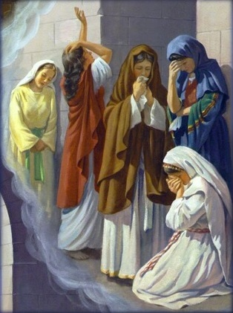
Yahuah’s Regard for the Pagan Captive
When Israel raided the pagan nations, taking captive maids, it would be very unusual for the maidens to not already follow the moon cycle system of counting.
Yahuah was very sympathetic towards captured maidens. They were to receive every Torah benefit.
In this way she could confidently count out her rightful days of mourning [through the moon phases] before being subjected to her captor,
before her allotted time.
Later, the captives would learn of Yahuah's worship Covenant Calendar.
There’s more to
this puzzle!

Slide 73



A) Comparing Num 10:10 to Deut 21:13
Num 10:10 (Torah)
Deut 21:13 (Torah)
Num 10:10 Also in the day of your gladness, and in your solemn days, and in the beginnings of your months [H2320] ye shall blow with
the trumpets …
Deut 21:13 And she shall put the raiment of her captivity from off her, and shall remain in thine house, and bewail her father and her mother a full month [H3391].
Both months of H2320 & H3391
appear to be synonyms.

Slide 74


#1 Puzzle Solving: Num 10 & Deut 21
Num 10:10 (Torah)
Deut 21:13 (Torah)
The wording is given as “blow the trumpet at the beginning of the month [H2320].”
The wording is given as
“a full lunar month [H3391]” for mourning of captivity.
Both Numbers 10 and Deuteronomy 21 are referring to very different months.
Num. [trumpet] “month” = H2320 – the “renewing” month of Yahuah with
roots in Day 1 of Creation.
Deut. [captivity] “month” = H3391 – the lunation month of Yahuah with roots in
Day 4 of Creation.
Num 10 and Deut 21 do NOT fit together!!
Yahuah’s H2320 month is never the same as the H3391 Lunar month.

Slide 75


B) Comparing Num 10:10 to Psa 81:3
Num 10:10 (Torah)
Psalm 81:3 (non-Torah)
Num 10:10 Also in the day of your gladness, and in your solemn days, and in the beginnings of your months [H2320] ye shall blow with
the trumpets …
Ps 81:3 Blow up the trumpet in the new moon [H2320],
in the time appointed on
our solemn feast day.
“new month” & “new moon”
… both appear to be synonyms. Are they?

Slide 76



A Closer Look at Num 10:10 & Psa 81:3
Num 10:10 & Psa 81:3 give instructions for when the trumpets are blown.
The context is not about one specific time on one specific day!
They were to blow the trumpets at these times:
On the 1st day of every new month [H2320] (for counting worship statutes);
At the fullness of the solemn holy feast days – when they are fully come;
On every feast day during the feast weeks.
Will Numbers 10 and Psalm 81 agree
to fit together?

Slide 77

#2 Puzzle Solving: Num 10 & Psa 81
Num 10:10 (Torah)
Psalm 81:3 (non-Torah)
The wording is given as “beginning of your month.”
The wording is given as “new moon [H2320].”
“month” = H2320
“moon” should be “month”
[when translated properly – more work on this later.]
Both Num 10 and Psalm 81 are referring
to the same H2320 “set-apart month” of 30 days,
or Yahuah’s month that began on the 1st day of creation.
The months of Psalms & Numbers are not linked to the moon.

Slide 78

Scrutinizing Psalm 81:3 & Num 10:10
Psa 81:3 Blow up the trumpet in the new moon month [H2320; renewal of 1st day of Yahuah’s month], in the time appointed [H3677; fullness],
on our solemn feast day [H2282; every festival].
Psa 81:3 must follow the Torah instructions given by Moses.
Num 10:10 Also in the day of your gladness, and
in your solemn days, and in the beginnings of your months [H2320; not H3391 lunar month], ye shall blow with the trumpets …
Between Psa 81:3 & Num 10:10
there is no mention of H3391.
H3391 never qualifies any lunar phase
to commence Yahuah’s feast months.
Psalm 81 & Numbers 10 do agree! This puzzle is solved!

Slide 79
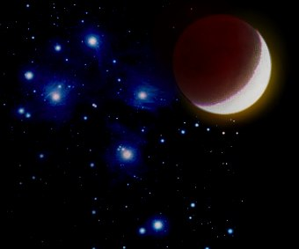
H3391 Final Conclusion <yerach>
Deut 33:14 is the very first H3391 Torah reference that aligns with a moon/month of 30 days (as are 11 of the 13 verses).
For 3300 years the “moon/month” had 30 days in its cycle
(which began its commencement on the 4th day of creation week).
Not one H3391 moon/month reference gives instruction to commence Yahuah’s set-apart month.
Only 2 references use the word MOON instead of MONTH referring to the agricultural or prophetic aspect of the MOON.
However, not one of the <13> H3391 verses lends any support
for the set-apart month to commence with any phase of the
MOON in the sky.
The
H3391 MOON
does not commence Yahuah’s
Festal month.

Slide 80
H3391 Final Conclusion (Con’t)
H3391 means the actual lunation or
“cycle of the moon” in any “moon month.”
Up until the sundial event, the moon month
and set-apart month, both had 30 days.
But, they did NOT commence on the same day!
And that’s all!
The
H3391 MOON
does not align with Yahuah’s
Festal month.

Slide 81


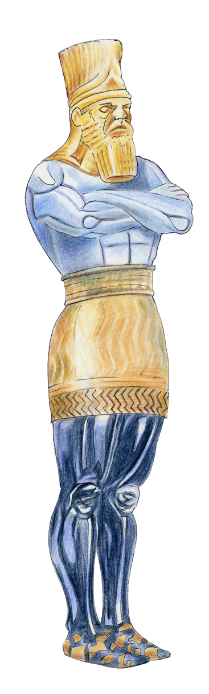
A Thought to Ponder
Some say Yahuah changes the “times” and “seasons.”
Does He?
And if so, what does this mean
for His Covenant Calendar?
?
CHANGE PLAN A
TO PLAN B

Slide 82
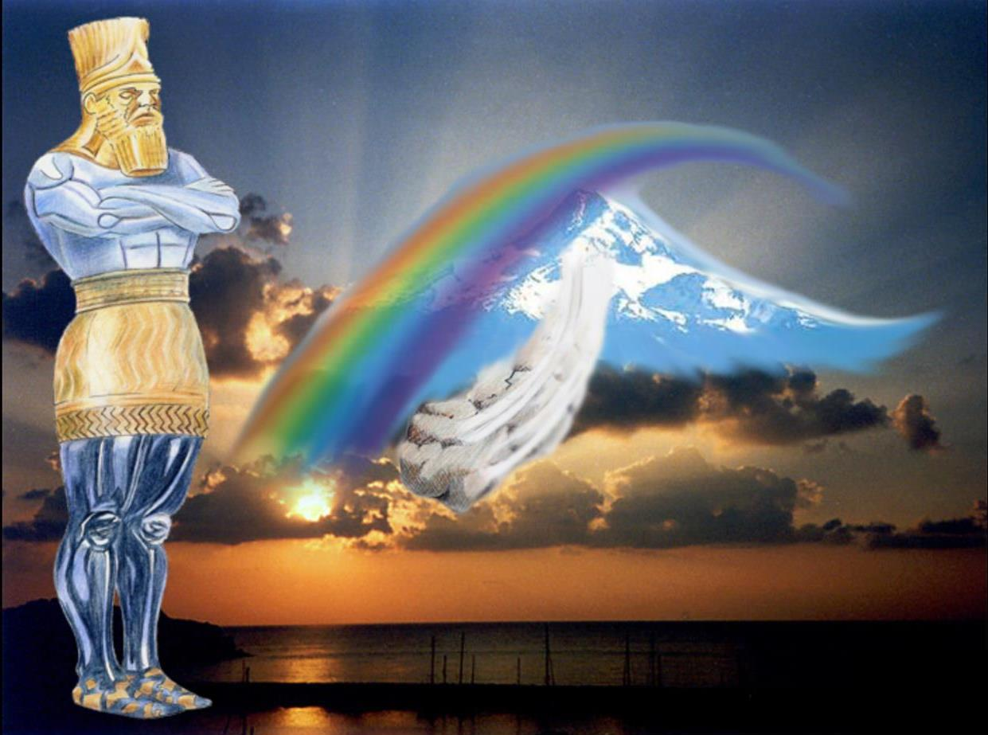
Definition: “seasons” [H2166]
Dan 2:21
seasons H2166 zeman (Aramaic); from H2165; the same as H2165:
KJV - season, time.
  H2165 zeman; from H2163;
  an appointed occasion:
  KJV - season, time.
    H2163 zaman (zaw-man');
    a primitive root; to fix (a time):
    KJV - appoint.
And he changeth the times [5732] and the seasons: [2166] he removeth kings, and setteth up kings: he giveth wisdom unto the wise, and knowledge to them
that know understanding.
When did Yahuah change any
“seasons” or appointed times?
82

Slide 83
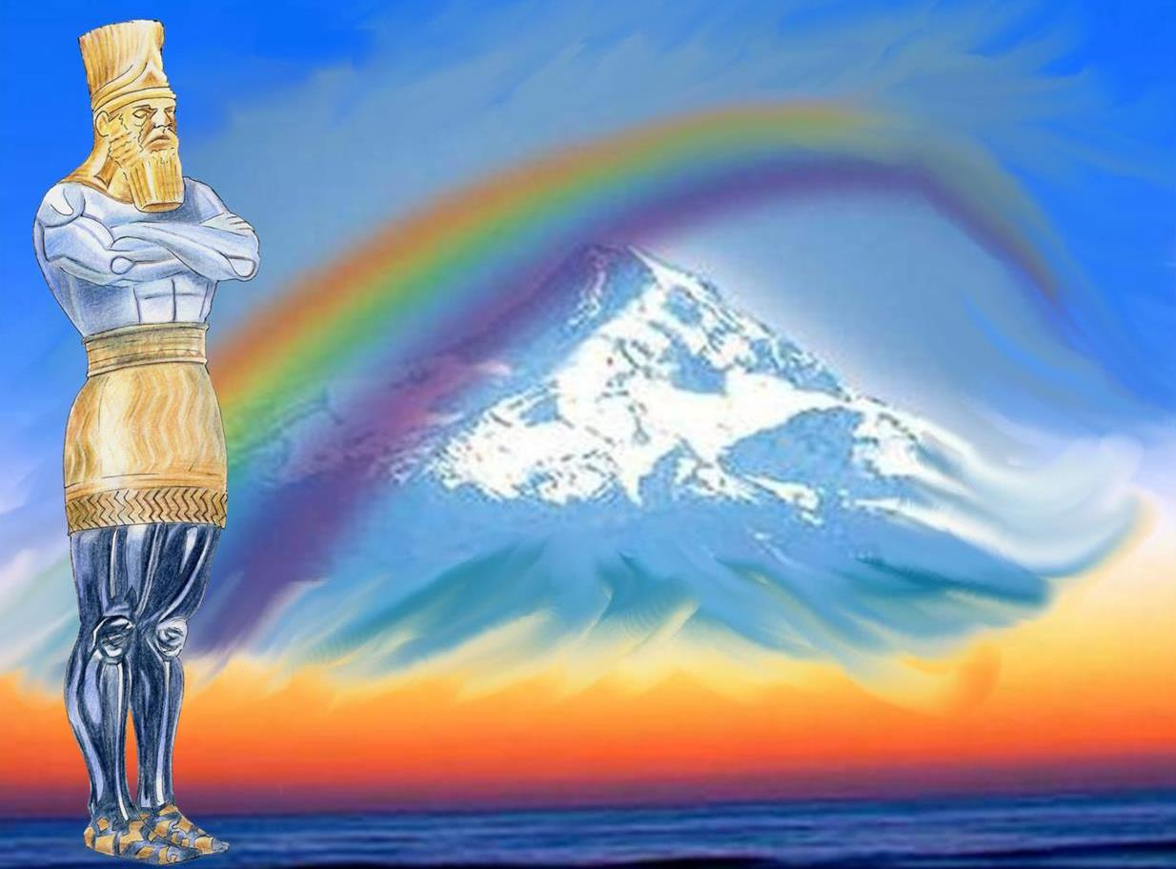
Definition: “times” [H5732]
Dan 2:21
times H5732; `iddan (Aramaic); from a root corresponding to that of H5708; a set time; technically, a year: KJV - time.
  H5708 `ed ; from an unused root meaning to set a period [compare H5710, H5749]; the menstrual flux
  (as periodical); by implication
  (in plural) soiling: KJV - filthy.
And he changeth the times [5732] and the seasons: [2166] he removeth kings, and setteth up kings.
How did Yahuah change any
“times” to became soiled/filthy?
Why?
83

Slide 84


Answers to Our Questions
Oh Moon!
1) Are you the master of
counterfeit calendars?
2) Does creation serve you?
3) Or do you serve creation?

Slide 85
Oh Moon!
Oh Moon!
Question #1:
Are you the master of
counterfeit calendars?
Yes, every calendar
that uses any phase
of the moon!

Slide 86

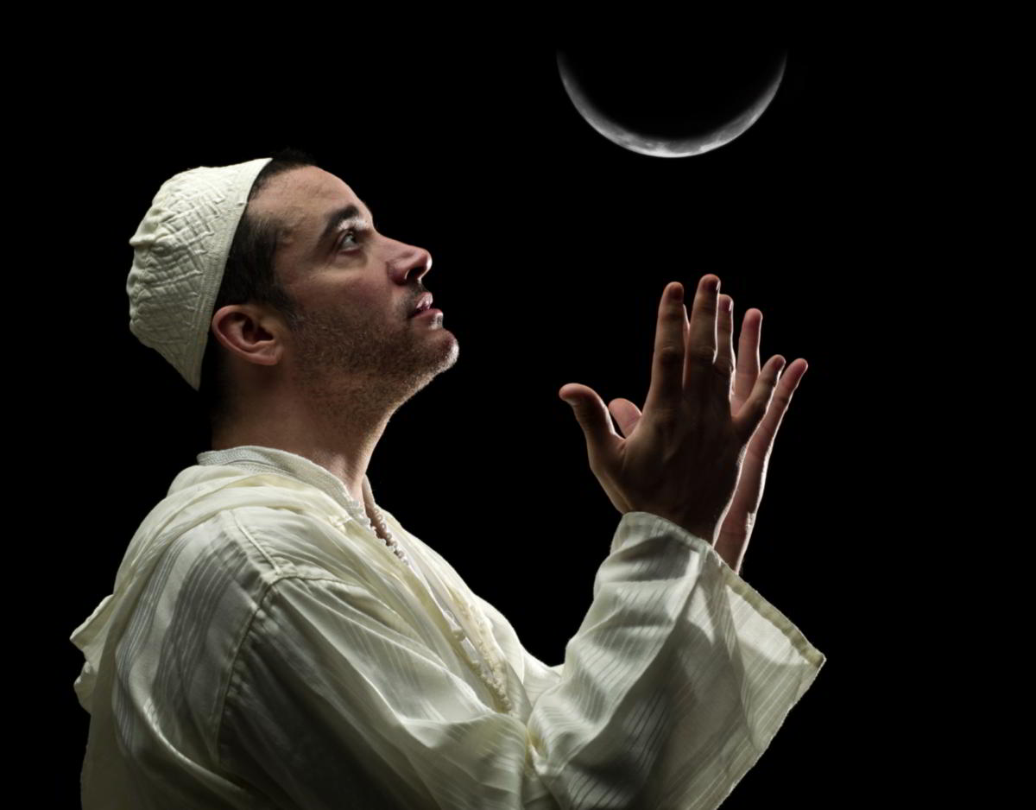


Oh Moon! Question #2:
Does creation serve you?
Yes!
Every new moon day & …

Slide 87
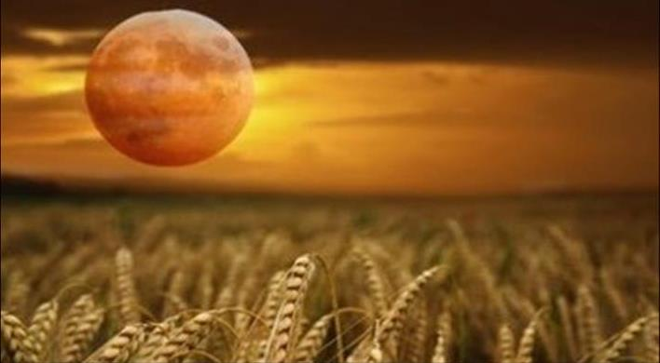
Question #3
Oh…Harvest Moon!
Do you serve creation?
Deut 33:14
… and for the precious things
put forth by the moon …
(ordinances of H3391 <yerach>)
Yes!

Slide 88
Back to our
Original Question
No!
Can the phases of the moon separate
or rule Yahuah’s Festal months?
The Hebrew H3391 <yerach> does not allow this option!

Slide 89

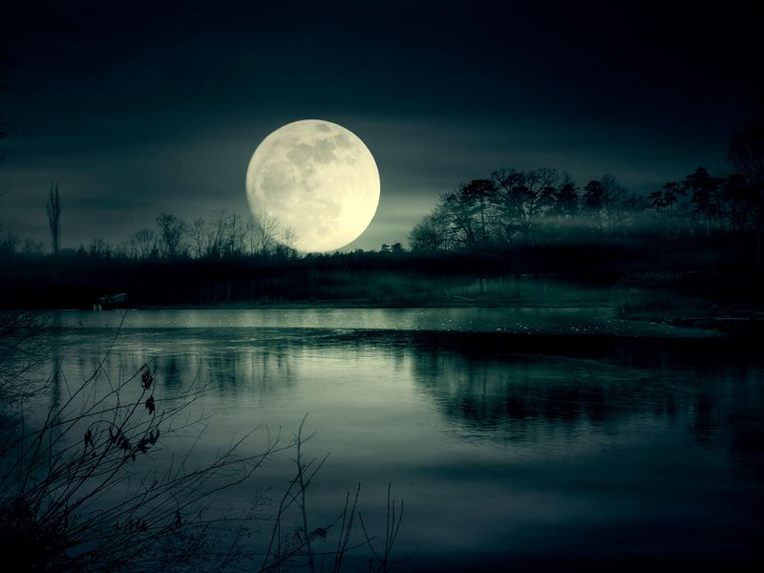

Question: Does the “moon” begin the “month”?
H3394 <yareach> The literal moon in the sky.
2. H3391 <yerach> Lunation cycle for the Synodic month.
3. H3842 <lebanah> The color/whiteness of the moon.
4. H7720 <saharon> Round objects compared to the moon.
No!
No!
Only
Ordinances
No!
No!
Not one of the 4 Hebrew Words for moon supports
Yahuah’s Festal month beginning with the moon.
So, where did this idea come from? Is it ALL man-made?

Slide 90




The next presentation will begin to
break open H2320 ~ the only Hebrew word
found in 20 non-Torah Scriptures
which names either
the Sabbath,
the festivals
and/or …
the “new moon” day …
or is it the “new month” day?
Notes:
.

Slide 91


Exposing the Counterfeit
to find the Truth About
H2320 <chodesh>
Part 5
“Yahuah’s Month!
Oh, Yahuah’s Month!”
(on Aug 17/18)
The End
Notes:
.

Slide 92




If you need assistance with this information, please send your questions to
Charlene Fortsch or
Timothy Astleford:
charlene@torahtothetribes.com
or
Shofar1owr@gmail.com

